Slide 1
Introduction to Web
Session 1: Web Fundamentals
2-Hour Session for Beginners

Slide 2
Welcome and Course Overview
Welcome to "Introduction to Web"
This course covers fundamental web concepts
We'll explore how the web works behind the scenes
By the end, you'll understand the journey of a web request

Slide 3
Prerequisites and Structure
Prerequisites: Basic HTML knowledge
Course Structure:
Session 1: Web Fundamentals (2 hours)
Session 2: Web Infrastructure (2 hours)
Learning approach: Concepts followed by simple exercises

Slide 4
The Internet vs. The Web
The Internet
A global network of interconnected computers that communicate using standardized protocols.
The World Wide Web
An information system built on top of the Internet where documents and resources are identified by URLs and linked by hypertext.

Slide 5
Internet vs. Web: Relationship
The Internet is the infrastructure:
Physical networks, cables, routers
Protocols like TCP/IP
The Web is a service on the Internet:
One of many Internet applications
Others include email, FTP, messaging

Slide 6
Brief History
1960s:
ARPANET - First network connecting computers
1983:
TCP/IP adopted - Birth of the Internet
1989:
Tim Berners-Lee proposes the World Wide Web
1993:
First graphical web browser (Mosaic)

Slide 7
Client/Server Architecture: Basics
Client:
A device or program that requests services or resources.
Examples: Web browsers, mobile apps
Initiates communication
Server:
A device or program that provides services or resources.
Examples: Web servers, database servers
Responds to client requests

Slide 8
Client/Server Communication
Communication follows a request-response pattern:
Client sends a request to the server
Server processes the request
Server sends back a response
Client receives and processes the response
[DIAGRAM PLACEHOLDER: Simple client-server communication flow showing request and response]

Slide 9
Types of Servers
Web Server:
Serves web pages (Apache, Nginx)
Application Server:
Runs application logic
Database Server:
Stores and manages data
File Server:
Stores and shares files
Mail Server:
Handles email (SMTP, POP3, IMAP)
DNS Server:
Resolves domain names to IP addresses

Slide 10
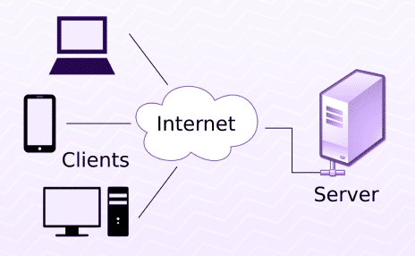
Client/Server Architecture Diagram
In this architecture:
Multiple clients can connect to multiple servers
Servers can communicate with each other
Each component has a specific role

Slide 11
HTTP Basics: Introduction
HTTP
(HyperText Transfer Protocol):
An application protocol for distributed, collaborative, hypermedia information systems.
It is the foundation of data communication for the World Wide Web.
HTTP defines how messages are formatted and transmitted, and what actions web servers and browsers should take in response to various commands.

Slide 12
HTTP Request Methods
GET:
Retrieve data from the server
POST:
Submit data to the server
PUT:
Update existing resource
DELETE:
Remove a resource
HEAD:
Same as GET but without response body
OPTIONS:
Get supported methods for a URL

Slide 13
HTTP Response Status Codes
1xx:
Informational responses
2xx:
Successful responses (200 OK)
3xx:
Redirection messages (301 Moved)
4xx:
Client error responses (404 Not Found)
5xx:
Server error responses (500 Internal Server Error)

Slide 14
HTTP Headers
HTTP headers allow the client and server to pass additional information with the request or response.
Request headers:
Accept, User-Agent, Cookie
Response headers:
Content-Type, Content-Length, Set-Cookie
Entity headers:
Content-Encoding, Content-Language
General headers:
Date, Connection

Slide 15
HTTP Example with HTML
Simple HTML form that sends data using HTTP POST method:
<form action="/submit-form" method="POST">
<label for="name">Name:</label>
<input type="text" id="name" name="name">
<label for="email">Email:</label>
<input type="email" id="email" name="email">
<button type="submit">Submit</button>
</form>

Slide 16
DNS Basics: Introduction
DNS
(Domain Name System):
A hierarchical and decentralized naming system for computers, services, or other resources connected to the Internet or a private network.
It translates human-readable domain names (like www.example.com) to machine-readable IP addresses (like 192.0.2.1).
Without DNS, we would need to remember IP addresses for every website we want to visit.

Slide 17
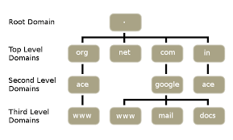
Domain Name Hierarchy
Domain names are organized in a hierarchical structure:
Root Domain:
Represented by a dot (.)
Top-Level Domain (TLD):
.com, .org, .net, .edu
Second-Level Domain:
example.com, google.com
Subdomain:
blog.example.com, mail.google.com

Slide 18
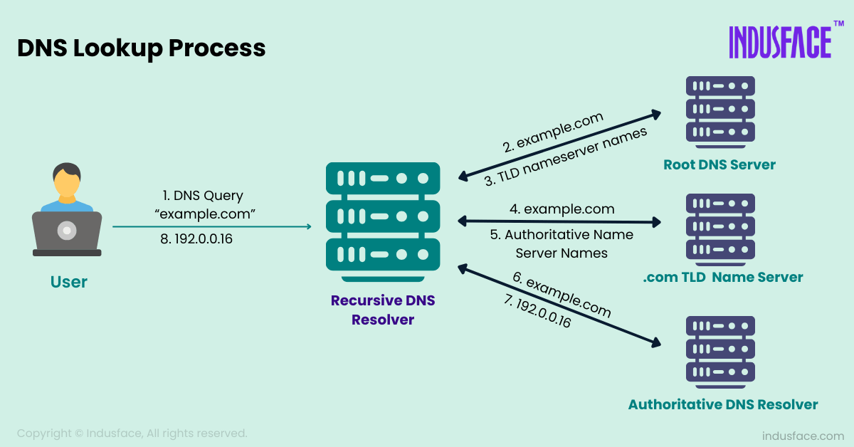
DNS Resolution Process
1. User enters a URL in the browser
2. Browser checks its cache for DNS records
3. If not found, OS checks its DNS cache
4. If not found, query is sent to DNS resolver
5. Resolver queries root, TLD, and authoritative name servers
6. IP address is returned to browser

Slide 19
DNS Record Types
A Record:
Maps domain name to IPv4 address
AAAA Record:
Maps domain name to IPv6 address
CNAME Record:
Creates an alias for another domain
MX Record:
Specifies mail servers for the domain
TXT Record:
Stores text information
NS Record:
Specifies authoritative name servers

Slide 20
Exercise 1: Client-Server Components
Identify which of the following are clients and which are servers:
Web browser
Email application
Database
Web hosting service
Mobile banking app
Question: What makes something a client versus a server?

Slide 21
Exercise 2: HTTP Analysis
Analyze the following HTTP request:
GET /index.html HTTP/1.1
Host: www.example.com
User-Agent: Mozilla/5.0
Accept: text/html
Questions:
What HTTP method is being used?
What resource is being requested?
Name two HTTP headers in this request.

Slide 22
Exercise 3: DNS Lookups
Match the following domain names with their likely purpose:
1. mail.company.com
A. Company's main website
2. company.com
B. Email server
3. blog.company.com
C. Company's blog
4. api.company.com
D. Developer interface
Question: How does DNS help organize different services for the same organization?

Slide 23
Session 1 Summary
In this session, we covered:
Next session will cover:
The difference between the Internet and the Web
IP addresses
Client/Server Architecture
Domain names and hosting
HTTP basics and request/response cycle
SSL/TLS and HTTPS
DNS and how domain names work
Complete web request flow

